Slide 1

Welcome to:
Open Forum
6:00 PM Wednesday, January 31, 2018
Broun Hall, Room 235

Slide 2



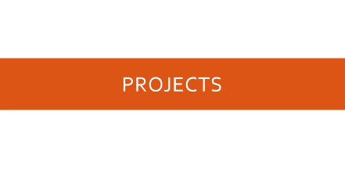
Agenda

Slide 3
About SPARC

Slide 4
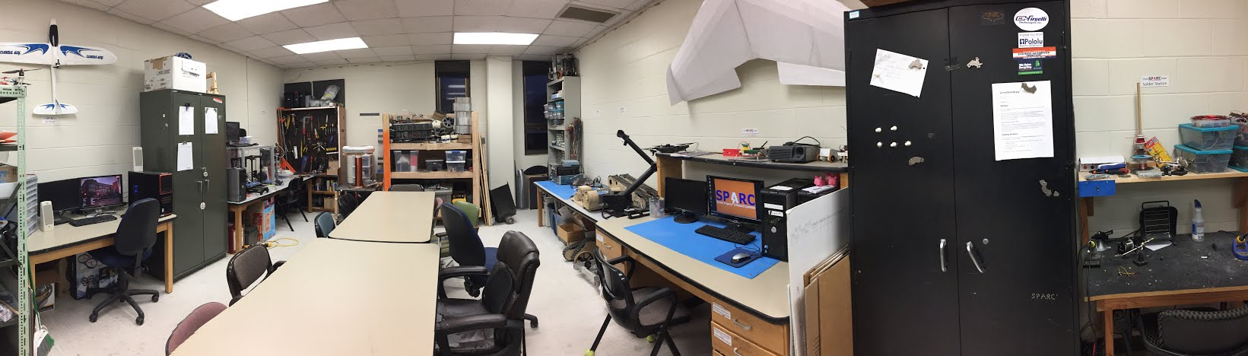
About SPARC
Creates and fosters an environment of creativity and innovation through collaborative projects.
A place to test out ideas, integrate concepts learned in class, and learn skills that will be instrumental when working in the workforce.
No prior experience is required, only a willingness to learn.
Join by logging 5 constructive hours in the lab on clipboard next to door and email sparc.auburn@gmail.com.
Lab:
- Broun 367
Maker Training Session:
- Tuesdays @ 5:30 in Broun 235
Open Forum:
- Wednesdays @ 6 in Broun 235

Slide 5



Partner Organizations
NASA Robotics Mining Competition Team
President: Jeremy Frasher <jjf0010@auburn.edu>
Meets on Mondays 6-7, SPARC Lab, Broun 367
RC Hobbyist Club
President: Craig Legrand <cbl0019@auburn.edu>
Meets on Mondays 3:30-4:30, SPARC Lab
Fridays 3:30-5:00, Broun 235
IEEE Auburn University Student Branch
President: Michelle Kniffen <mek0027@auburn.edu>
Meets on announced Mondays, Broun 238

Slide 6
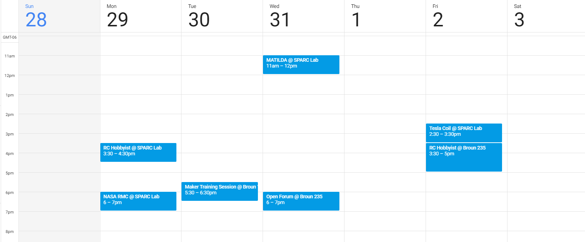
Meetings this Week

Slide 7
Outreach

Slide 8
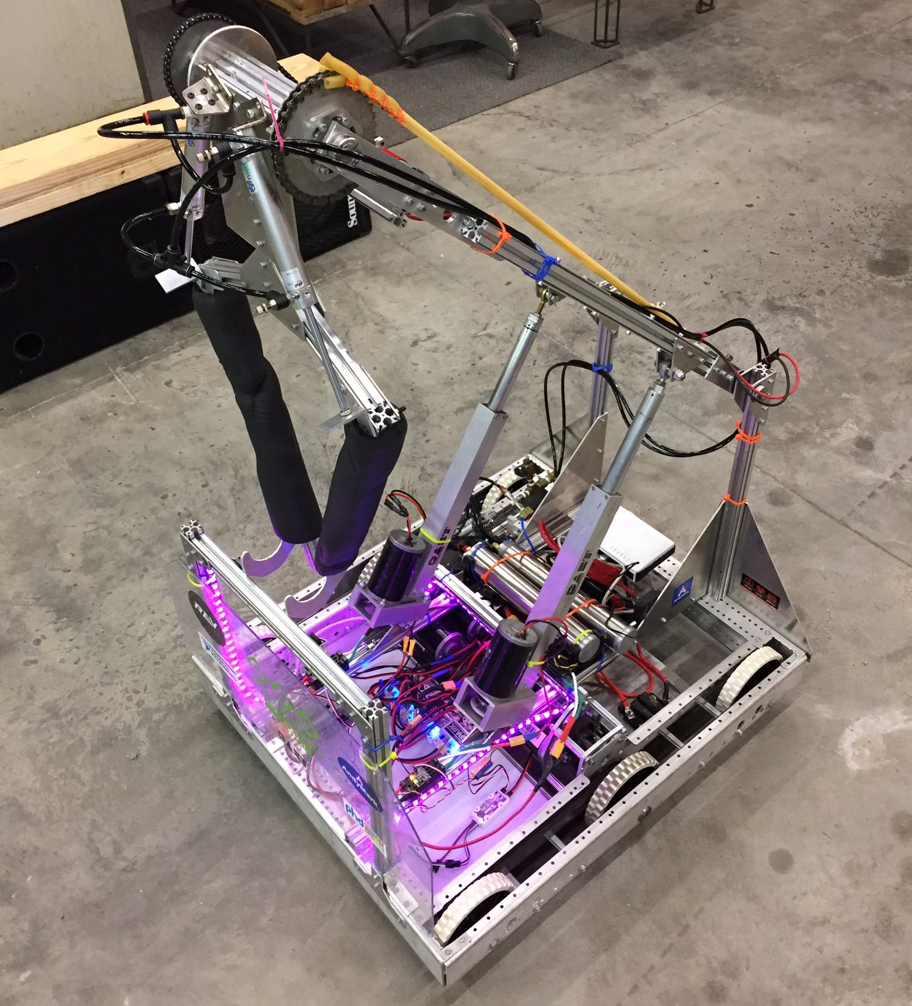
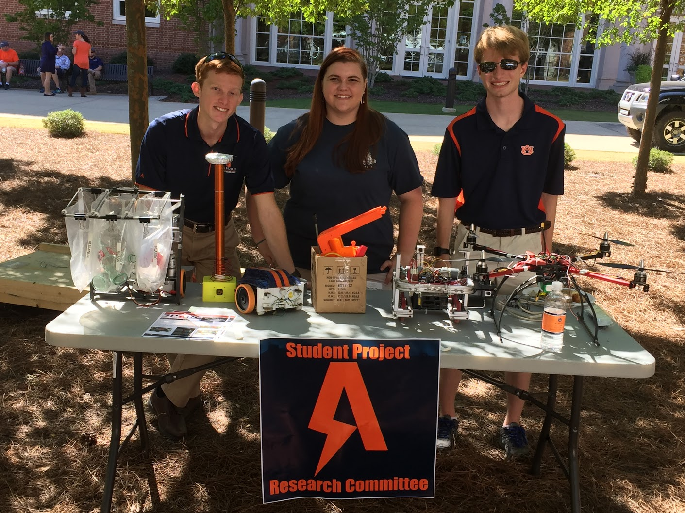
Outreach Events
Opelika HS FRC Team
Help mentor a FIRST Robotics Competition (FRC) Team
Mon Tue Thu: 3:30-6:30, Fri: 3:30-9:30, Sat:10-6
E-Day
Help display projects in Broun, Student Center, and Concourse to high school students.
Friday, February 23rd
Robot in 3 Days 2018 Bot
Engineering Tailgate 2016 SPARC Table
Notes:
Fall 2016
Loachapoka Robotics Mentoring- Mondays, Tuesdays, and Thursdays 3:00PM to 4:30PM
ECE Minority Presentation- November 14th
AJHS E-Day- November 17th
South’s Best- December 3-4th
SCORE Claw Machine- December 3-4th
Spring 2016
E-Day- Late February or early March
SPACE Day- Possible Event Next Semester
IEEE Sumo Robotics Competition (with local middle and high schools)- Spring 2017

Slide 9
Projects

Slide 10
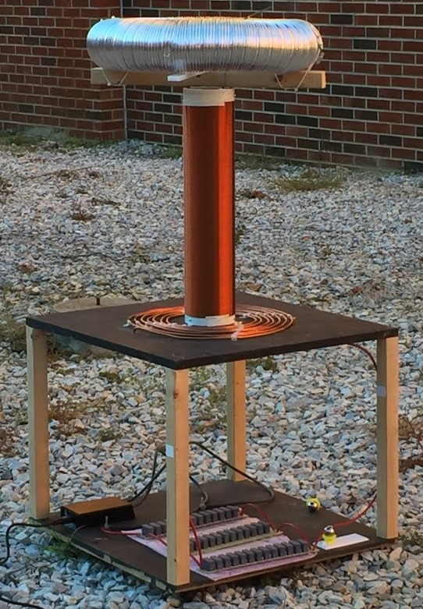
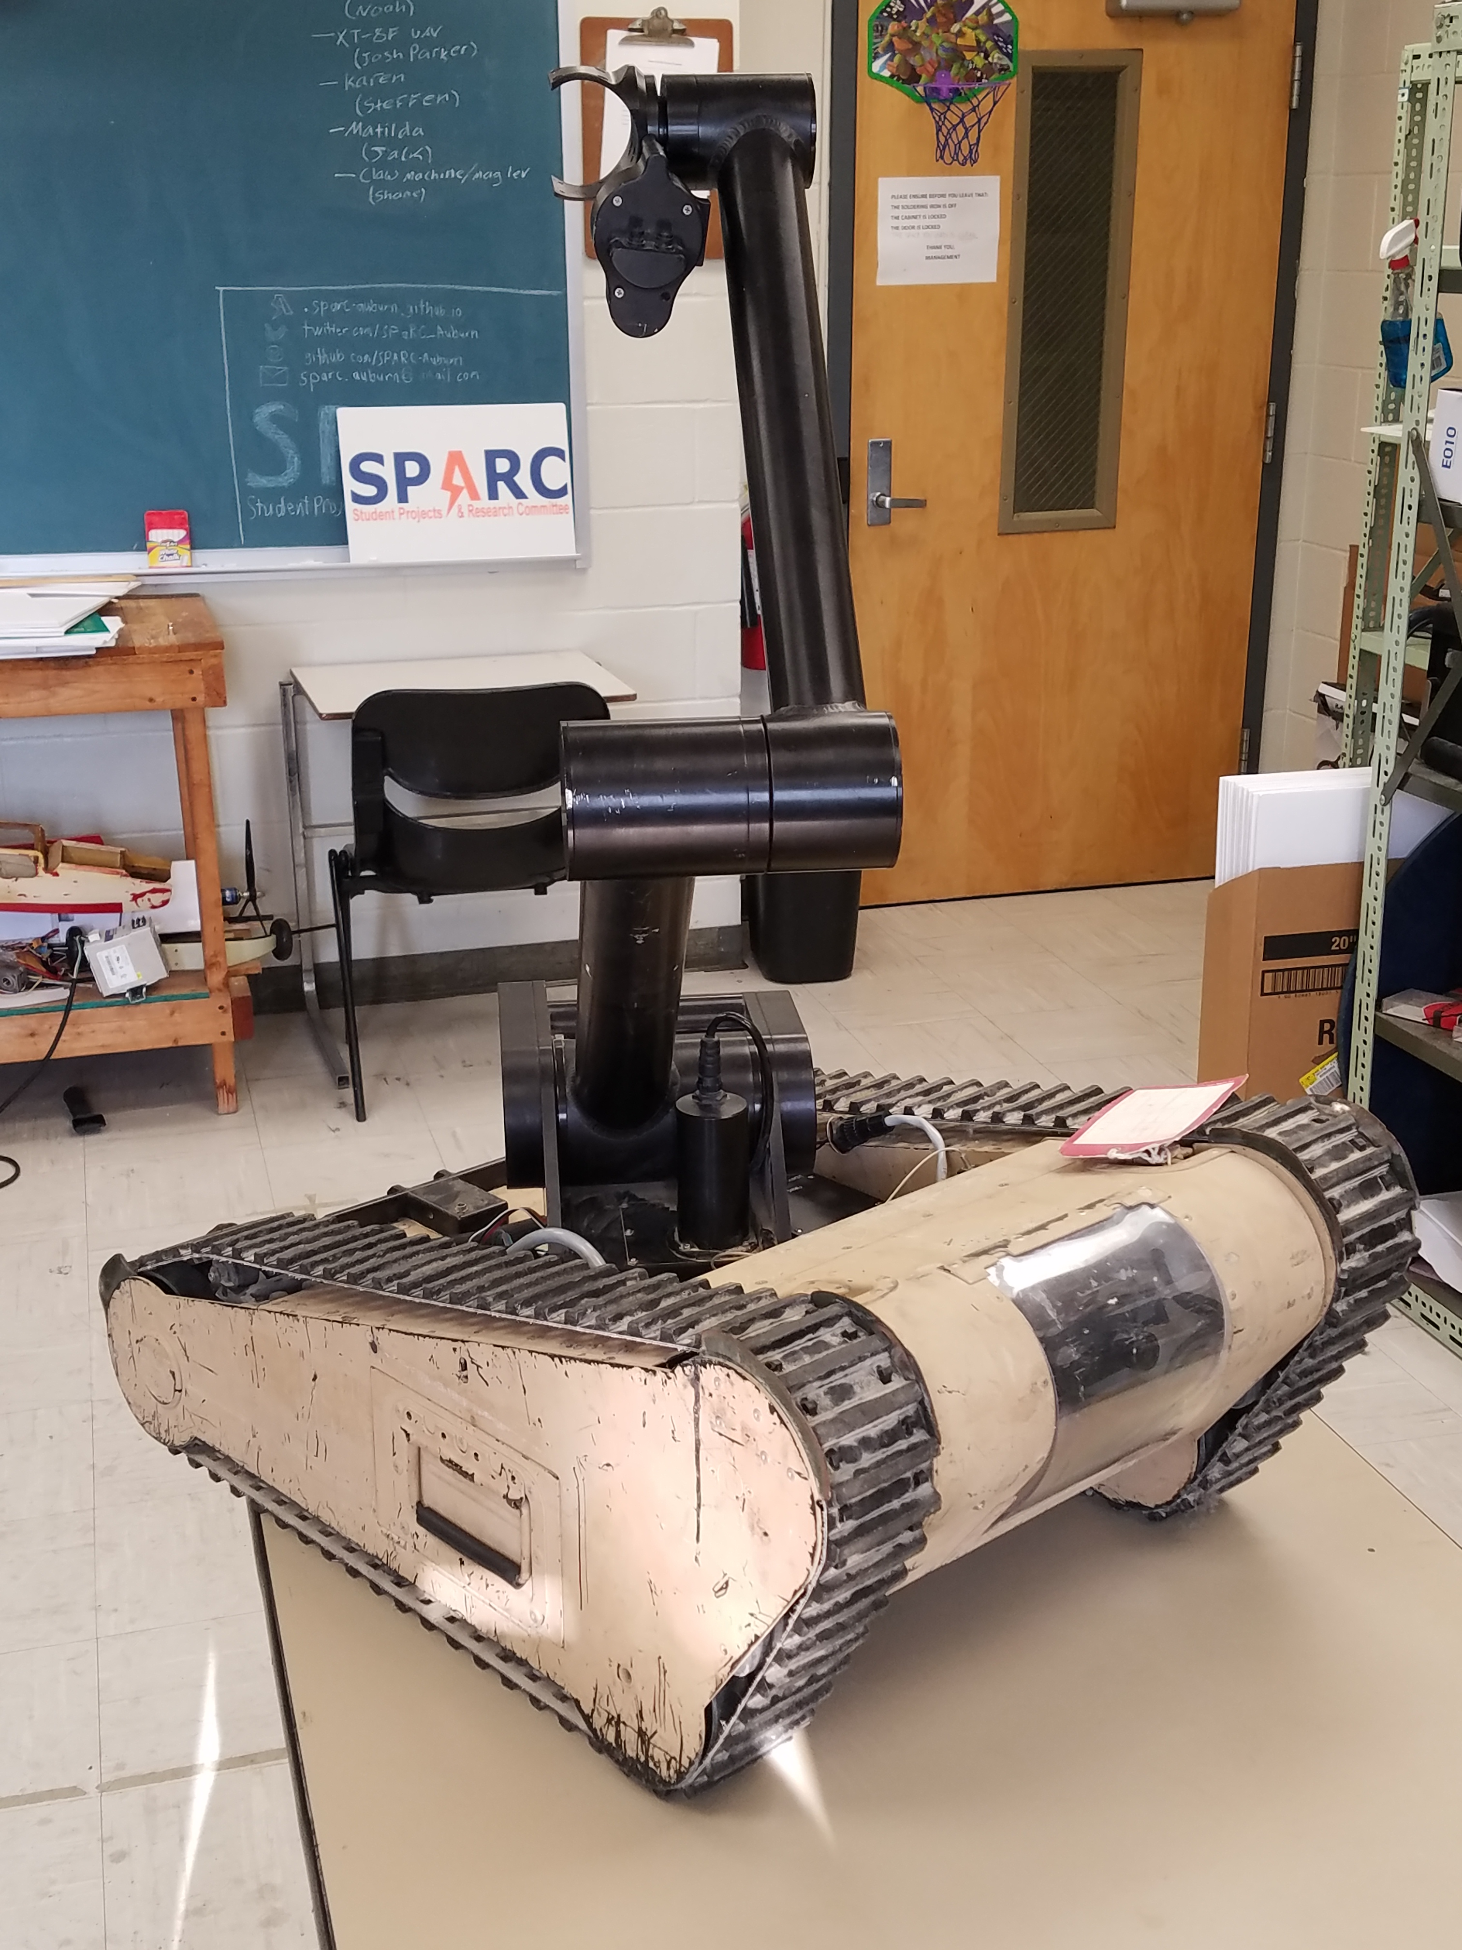
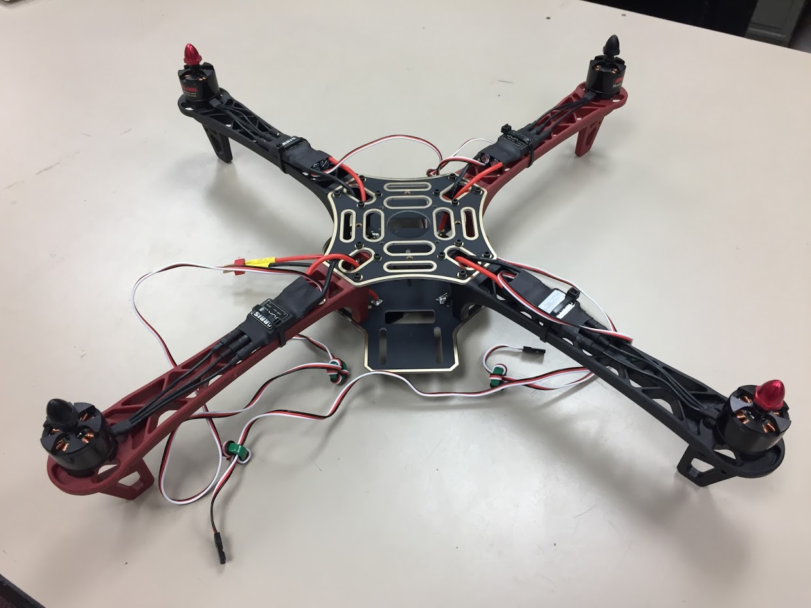
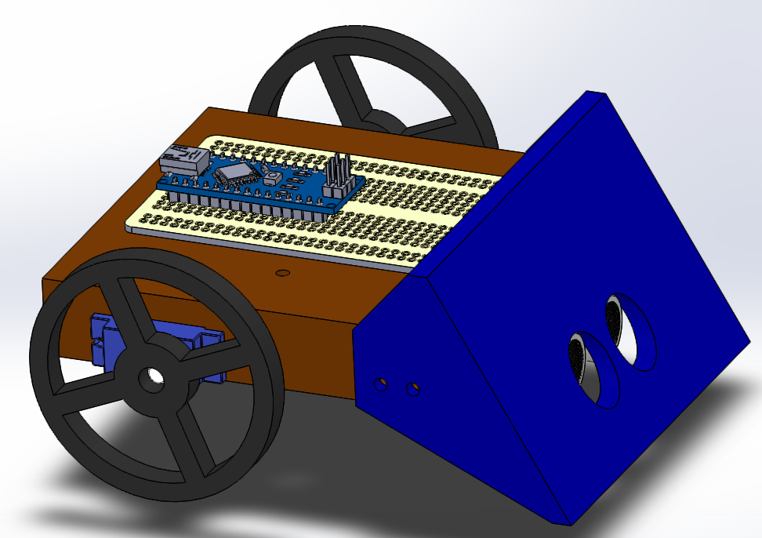
Spring 2018 Main Projects
MATILDA Robotics Platform
Tesla Coil
Unmanned Aerial Systems
Sumo Bot Competition

Slide 11
Project: MATILDA
Project lead: Jack Thomas
Slack Channel: #projectmatilda
MATILDA stands for Mesa Associates' Tactical Integrated Light-Force Deployment Assembly
A bomb disposal robot from Dr. Roppel’s research lab.
Is in disrepair both electrically and mechanically.
Semester Focus
Reestablishing mobility.
Reestablish arm control
Meeting Time
Wednesdays at 11:00 AM in SPARC Lab

Slide 12
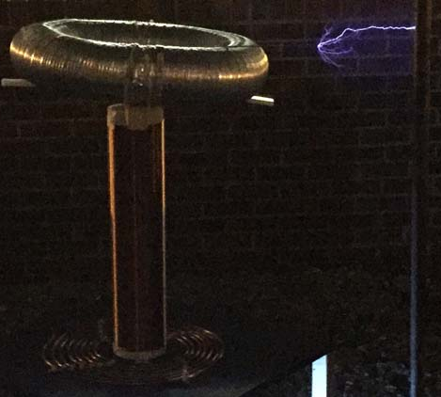

Project: Tesla Coil
Project lead: Josh Jablonowski
Slack Channel: #projectteslacoil
Demonstrated Tesla Coil at Spring 2016 E-Day
Use spark gap style circuitry
Generated estimated 400,000 volts of electricity.
Semester Focus:
Make it operational again (new capacitors)
Potentially convert it into a musical Tesla Coil.
Meeting Times
Fridays at 2:30 PM in SPARC Lab

Slide 13
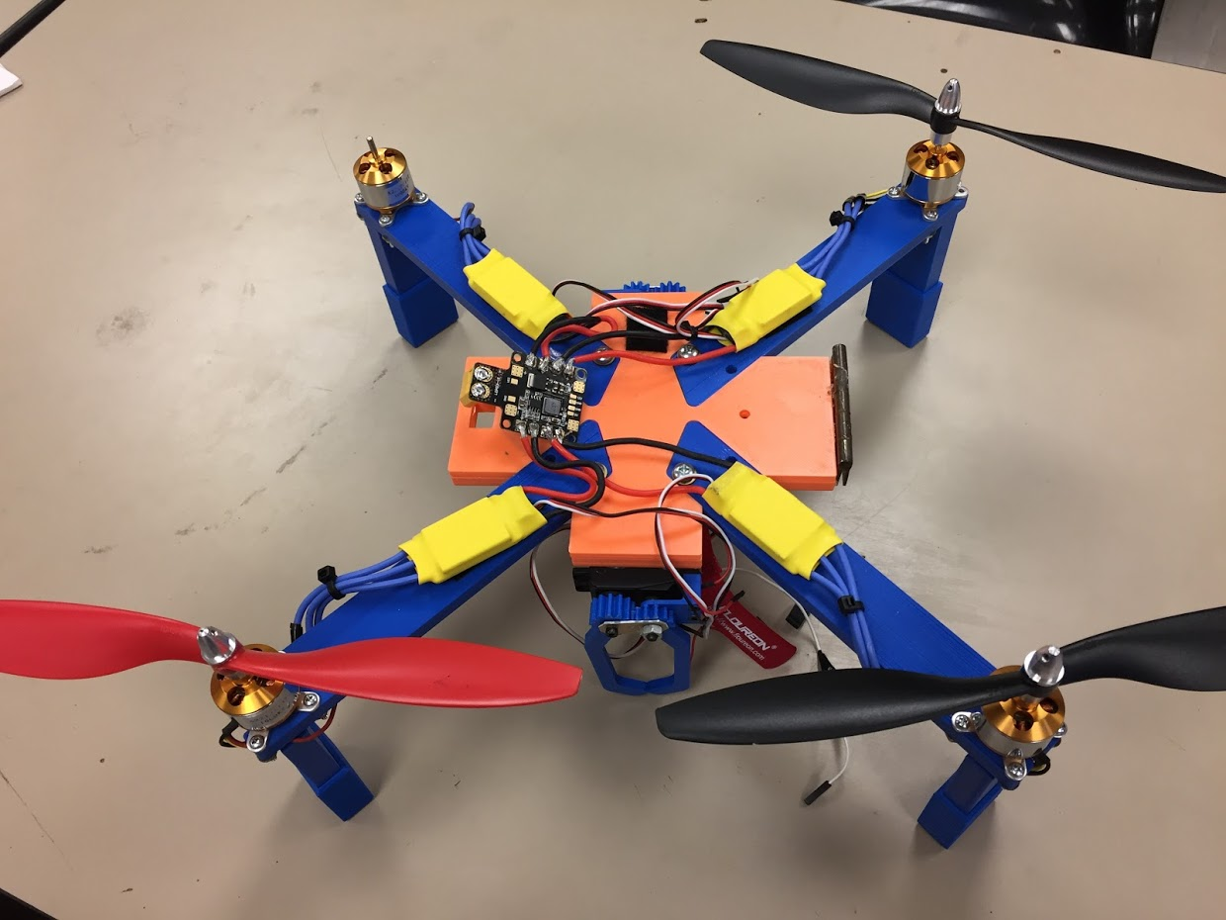
Project: Unmanned Aerial SysTems
Project lead: Mike Petry
Slack Channel: #projectuas
Partnership with RC Hobbyist Club
SPARC owns two quadcopter frames.
Will be used to experiment with many applications
Autonomy- search and follow
Camera Gimbal- stable video capture
Payload- pickup, identification, and delivery
Semester Focus
Get at least one frame flying
Start looking into camera gimbal
Meeting Times
TBD

Slide 14
Project: Sumo Bot Tournament
Project lead: Matthew Castleberry
Slack Channel: #projectsumobot
Will be the final project for the Maker Training Sessions.
Attendance at Maker Training Sessions are not required to compete.
Will utilize many different topics in engineering
mechanical design
3D printing
electrical prototyping
sensor and control systems
C programming
Meeting Time
Tuesdays at 5:30 PM in Broun 235

Slide 15
Open Forum Topic: Virtual Reality Tech.

Slide 16
What is VR?

